Slide 1
QUIZ SOCIETY
SHRI RAM COLLEGE OF COMMERCE
2012-13
THE ANNUAL QUIZ FEST OF SRCC
SPONSORSHIP PROPOSAL

Slide 2
SRCC
FOREMOST ACADEMIC INSTITUTION IN INDIA
BRIGHTEST MINDS OF THE COUNTRY
MOST REPUTED FACULTY
RECRUITMENTS BY MULTINATIONAL COMPANIES

Slide 3
QUIZSOC
FORMED IN 2009
LARGEST QUIZZING SOCIETY IN INDIA-OVER 80 MEMBERS
RIGID 3-PART RECRUITMENT PROCESS TO ENSURE BEST MEMBERS
MEMBERS INCLUDE STATE AND NATIONAL LEVEL QUIZ CHAMPIONS
BEST QUIZZING TEAM IN THE COUNTRY
LARGEST UNDERGRADUATE LEVEL QUIZ FEST IN INDIA
PAST QUIZZES CONDUCTED BY REPUTED QUIZMASTERS
DIVIDED INTO VARIOUS WINGS FOR EFFICIENT PERFORMANCE

Slide 4
ANNUAL QUIZ FEST OF SRCC
NATIONAL LEVEL PARTICIPATION
BOTH UNDERGRADUATE AND POST-GRADUATE LEVEL
DIFFERENT CATEGORIES
CASH PRIZES
GIFTS AND COUPONS

Slide 5
ILLUME
BUSINESS QUIZ
BOLLYWOOD QUIZ
GENERAL QUIZ
SPORTS QUIZ
ENVIRONMENT QUIZ
LITERATURE QUIZ
CRICKET QUIZ
Notes:
M.E.L.A.= MUSIC, ENTERTAINMENT, LITERATURE, ARTS

Slide 6
QUIZIGNIA
HELD ON SEPTEMBER 25, 2012
INTER-COLLEGE QUIZ COMPETITION
BIGGEST QUIZ FEST IN DELHI-NCR
CONDUCTED BY REPUTED QUIZMASTER
PARTICIPATION OF OVER 70 COLLEGES
VARIOUS ROUNDS COVERING A RANGE OF GENRES
MASSIVE AUDIENCE PARTICIPATION

Slide 7
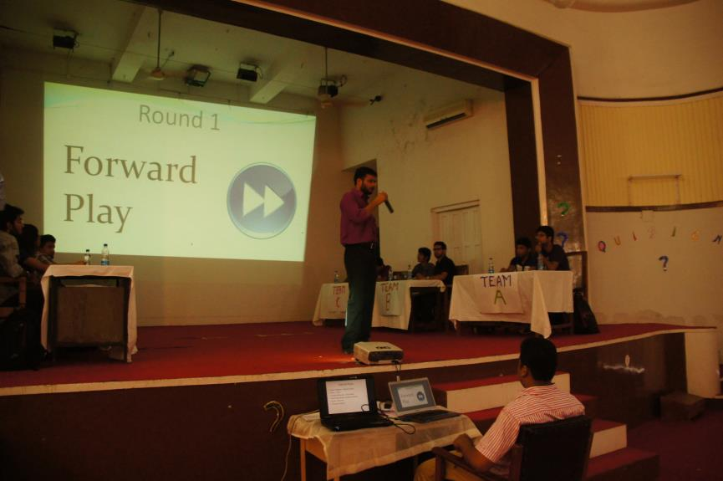
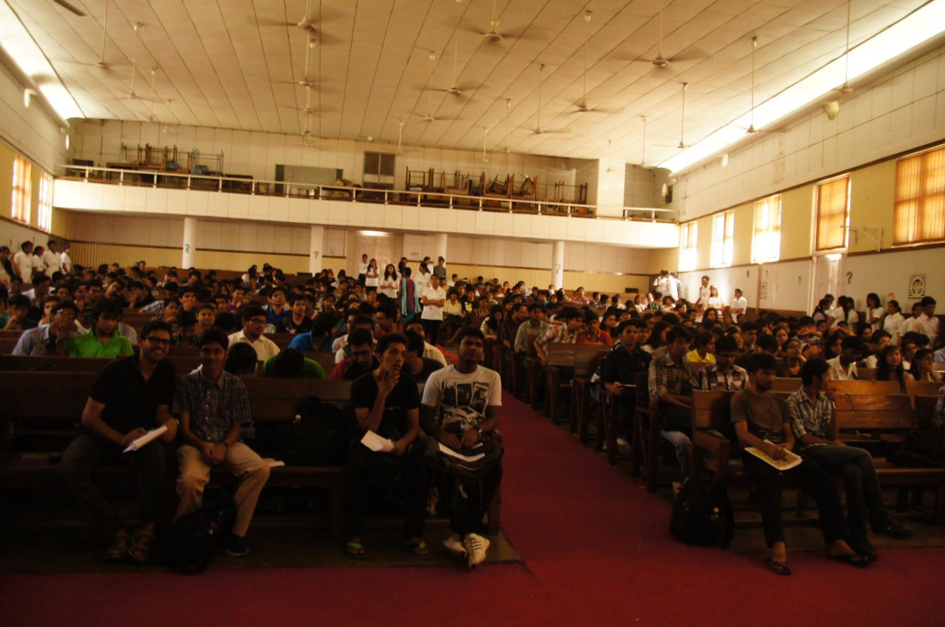
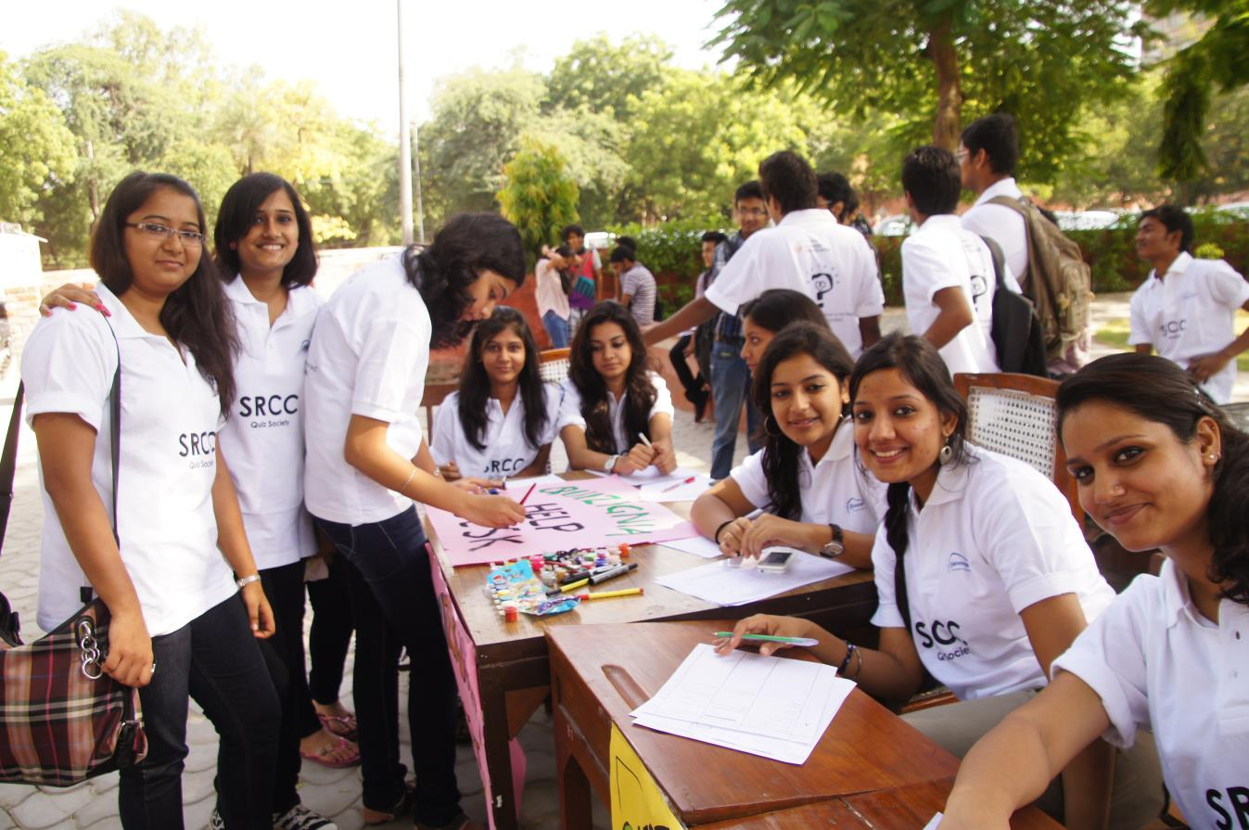
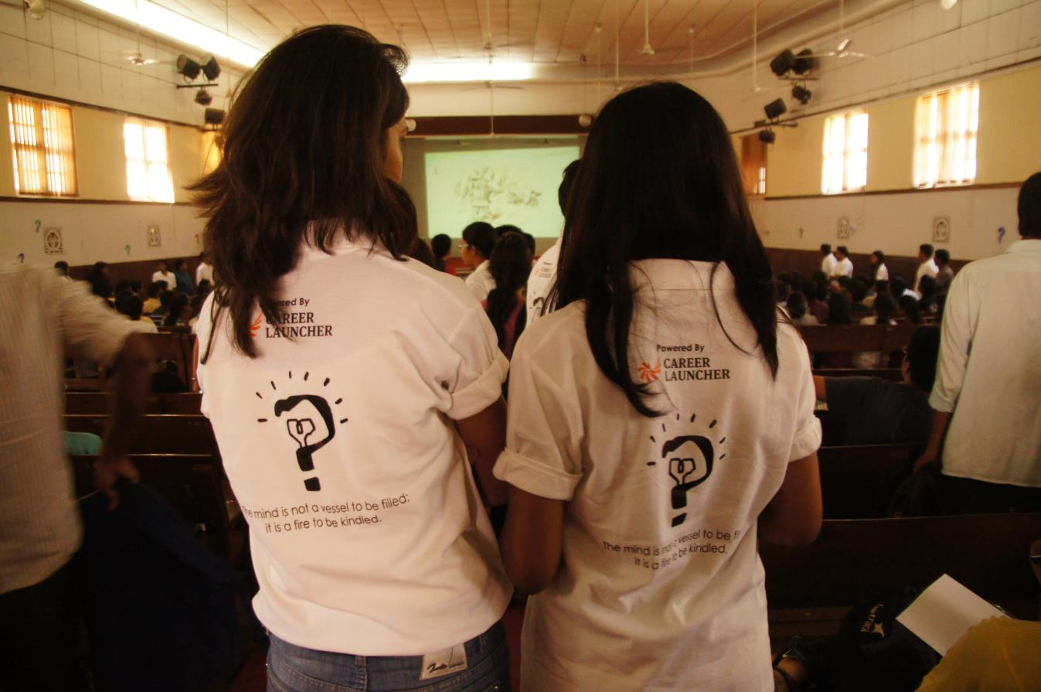
PICS FROM QUIZIGNIA’12

Slide 8
Sponsorship Benefits
Name of the Sponsors shall appear on the flexes which will be put up around the college campus.
Events shall be named after the Sponsors.
Name of the Sponsor shall be announced frequently during the fest.
Sponsor’s name will appear on all the backdrops of events.
Sponsor’s name will appear on all the posters put in SRCC, other colleges and other popular hangouts and eating joints.
Sponsor’s name will appear on the invitations sent to all the colleges and the premium pages of the brochures.
Sponsors will be facilitated to put banners in the college campus and nearby areas during the fest.
Sponsors will be allowed to put up stalls in prominent college locations (subject to prior permission from college authorities).
Sponsors shall be allowed to distribute pamphlets, leaflets, brochures, coupons, etc. during the fest.
NOTE:
Sponsorship benefits are directly proportional to the level of sponsorship offered.
Sponsorship can be offered in cash as well as kind, although sponsors who offer cash shall be given a higher priority.

Slide 9
PAST SPONSORS

Slide 10
Flex Design
TITLE SPONSOR
&
QUIZ SOCIETY, SRCC
PRESENTS
ILLUME
POWERED BY POWER SPONSOR
IN ASSOCIATION WITH ASSOCIATE SPONSOR1&ASSOCIATE SPONSOR2
EVENT SPONSORS EVENT SPONSORS EVENT SPONSORS EVENT SPONSORS
OTHER SPONSORS OTHER SPONSORS OTHER SPONSORS OTHER SPONSORS

Slide 11
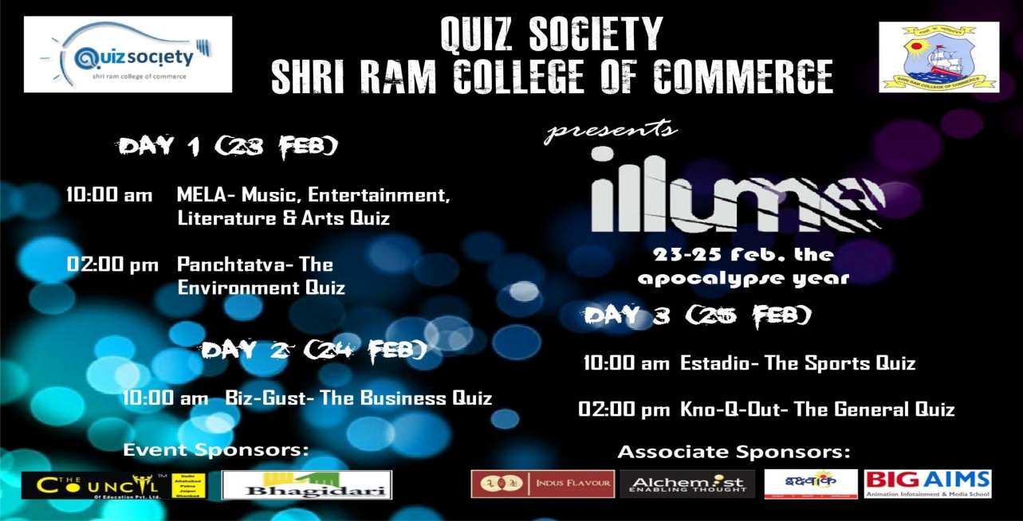
CONTACT US
SUSHANT AGARWAL (PRESIDENT) 9953418792
ASHISH SAINI (SECRETARY) 9818089711
SHAUNIK DHIR (SPONSORSHIP HEAD) 9953539267
Email: quizsociety.srcc@gmail.com
Website: www.quizsocietysrcc.in

